Slide 1
BIA WORKSHOP – POWER BI USING DAX
Prepared exclusively for 2023 BIA Graduating Seniors (with an INFO 3300 prereq)
Amy L. Phillips, Emerita Teaching Professor Department of Business Information & Analytics Daniels College of Business, University of Denver Amy.Phillips@du.edu

Slide 2
Workshop Prerequisites and Resources
Software
Microsoft Power BI Desktop (Windows only) https://www.microsoft.com/en-us/download/details.aspx?id=58494
or https://apps.microsoft.com/store/detail/power-bi-desktop/9NTXR16HNW1T
Workshop files
You must download and unzip the Dashboard in a Day class content from https://github.com/amyphill/DIAD_BIA

Slide 3
Workshop Audience and Purpose
Workshop audience: 2023 BIA Graduating Seniors (with an INFO 3300 prereq)… who want to learn more about Power BI and DAX
Workshop description: A one-day, hands-on workshop that covers more capabilities of Power BI than what was offered in INFO 3300
Power BI is an interactive data visualization software product developed by Microsoft with a primary focus on business intelligence that gives a single view of your data, with the ability to monitor the health of your business using live dashboards, interactive reports and accessing your data on the go, from your mobile devices

Slide 4
Workshop Agenda
Morning
09:00AM – 09:15AM | Power BI Overview and Demo
09:15AM – 10:00AM | LAB 1 - Data preparation and DAX (LO1)
10:00AM – 10:15AM | Break*
10:15AM – 12:00PM | LAB 2 - Data exploration, data visualization and DAX (LO2)
12:00PM – 12:30PM | Break for lunch
Afternoon
12:30PM – 01:30PM | LAB 3 - Data analytics and DAX (LO3)
01:30PM – 01:45PM | Break*
01:45PM – 03:00PM | LAB 4 - Data communication and DAX (optional Power BI Service demo) (LO4)
03:00PM – 03:30PM | Q&A
Notes:
LO1: Connect to, import, and transform data from a variety of sources (and DAX)
LO2: Explore data using data visualization (and DAX)
LO3: Utilize the data analytics features (and DAX)
LO4: Build an interactive dashboard (and DAX)

Slide 5
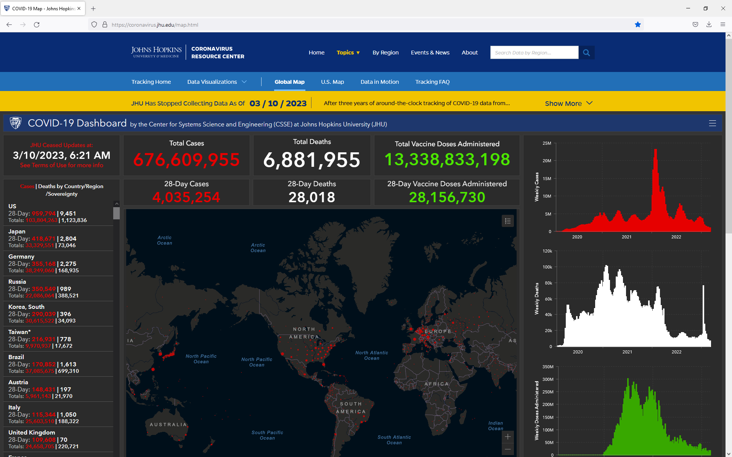
Dashboard in a Day using Power BI

Slide 6
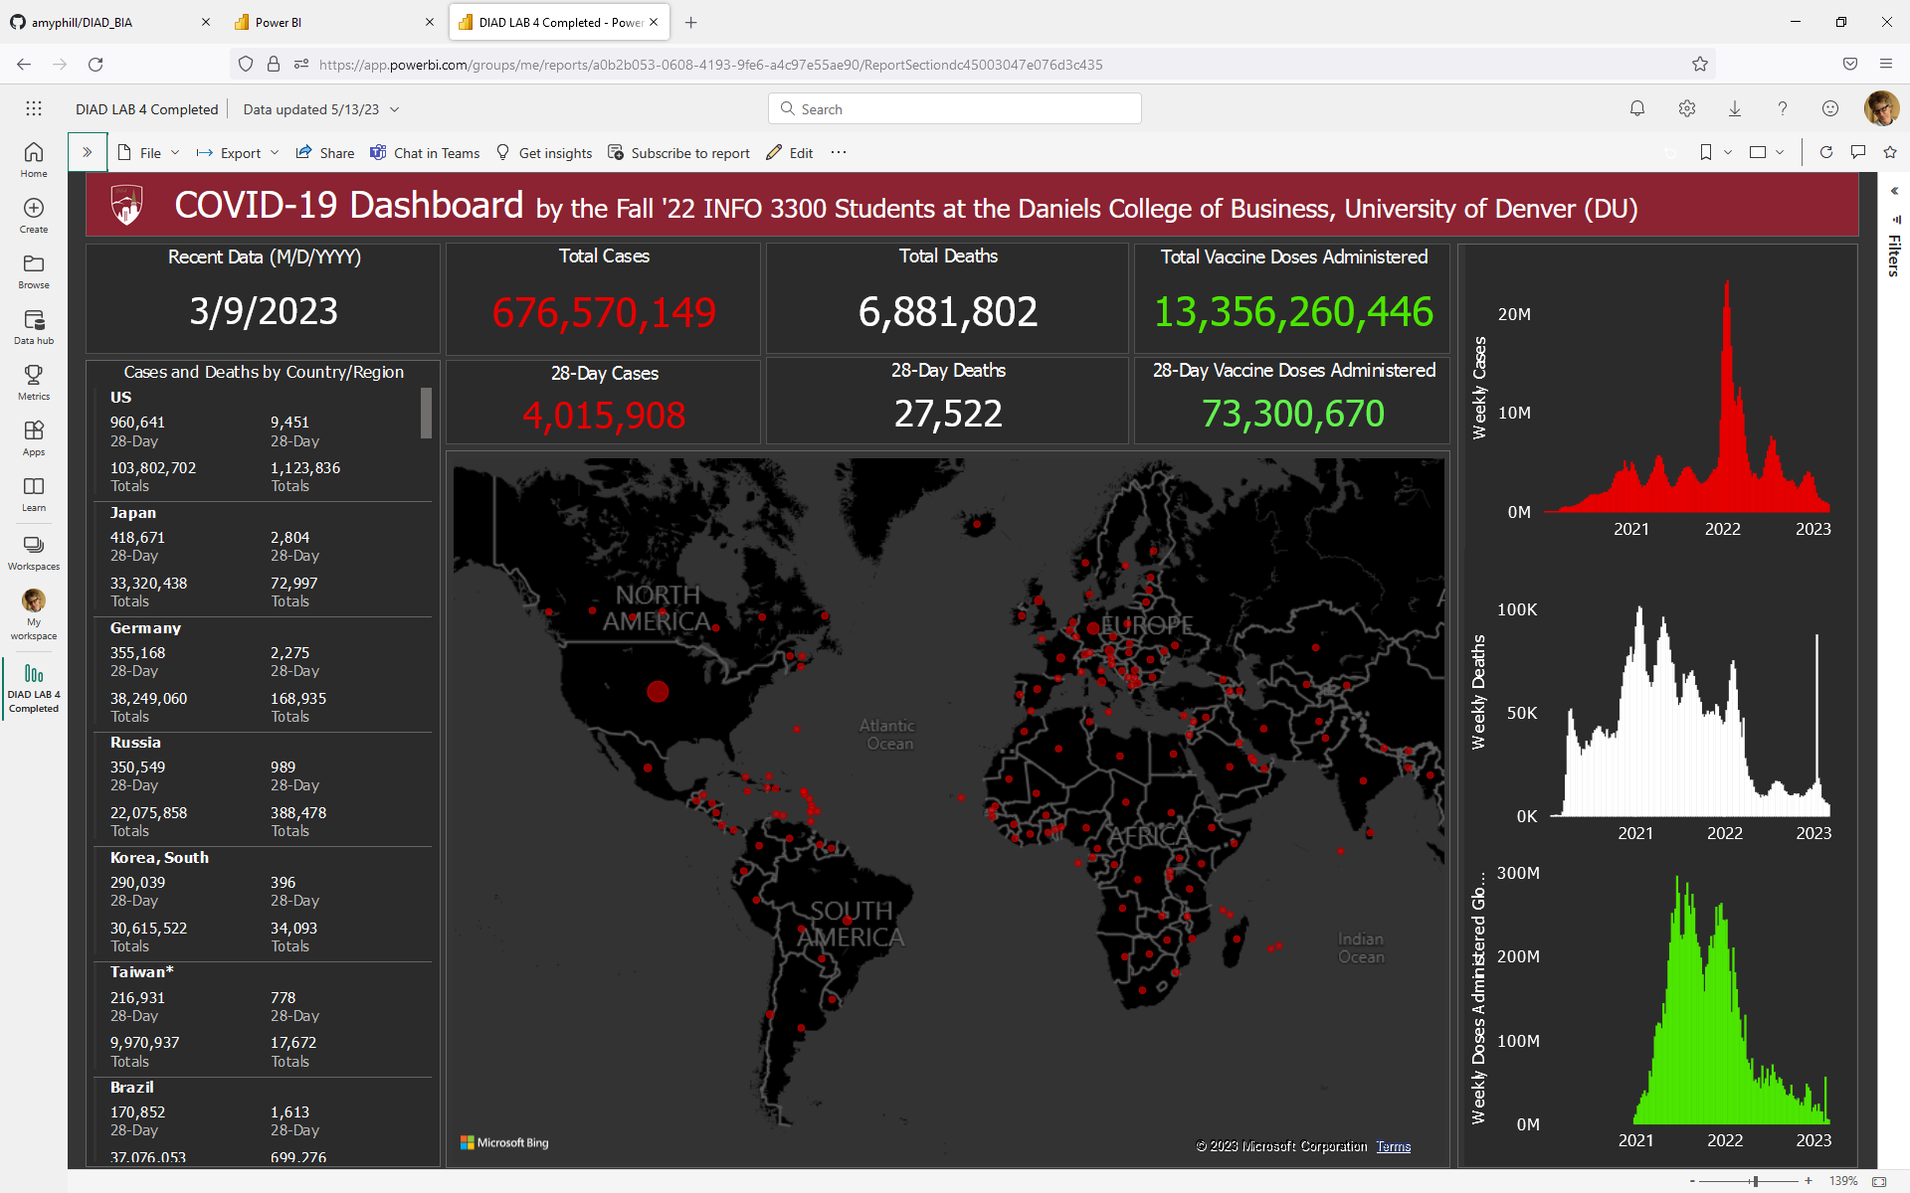
Dashboard in a Day using Power BI

Slide 7
Before We (Really) Get Started… Terms Often Associated with Dashboards
Data analytics vs Data visualization vs Data storytelling vs Visual analytics
Data analytics involves collecting and analyzing (large) data sets with the goal of finding trends and gleaning insights
Data visualization involves presenting data using visual representations usually in the form of charts, graphs, maps, tables and comprehensive dashboards
Data storytelling involves conveying data not just in numbers or charts, but as a narrative that can be comprehended
Visual analytics involves the science of analytical reasoning supported by interactive visuals
Notes:
Sometimes the terms are used interchangeably
Data analytics, data visualization and data storytelling are very different areas that require distinctive skill sets
One does not work well without the other
Visual analytics combines data analytics with data visualization… does not typically include data storytelling
To be effective, data analytics, data visualization and data storytelling must work in tandem

Slide 8
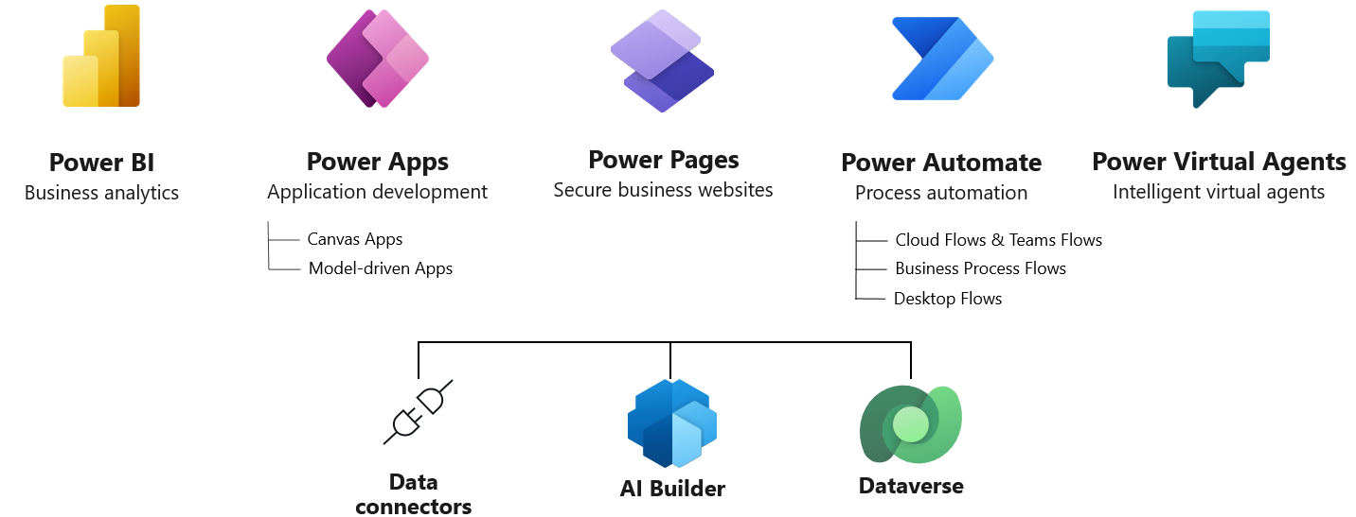
Power BI Overview and Demo
Microsoft Power Platform - The low-code platform that spans Office 365, Azure, Dynamics 365, and standalone applications
Source: https://powerplatform.microsoft.com/en-us/
Notes:
When it comes to analytic tools and solutions, it’s important to know what’s out there and to leverage solutions that work with Power BI to support better and faster decision making. Microsoft Power Platform is a collection of SaaS services that enables users to do three key actions on data that help them drive the business:
Power BI is providing the Business Intelligence part of the digital feedback loop.
The next step is the Action.
Take action based on your data driven decision, use Power Apps, Power Automate and Power Virtual Agent
Analyze | Make sense of your data through interactive, real-time dashboards and unlock the insights needed to drive your business forward
Act | Build apps in hours—not months—that easily connect to data, use Excel-like expressions to add logic, and run on the web, iOS, and Android devices
Automate | Include powerful workflow automation directly in your apps with a no-code approach that connects to hundreds of popular apps and services add virtual bots to automate your service and communication, using Power Virtual Agents
Power Platform enables everyone to be working together, using your data to help EVERYONE, from the CEO to the front-line workers, drive the business decision with data and enables innovation.

Slide 9



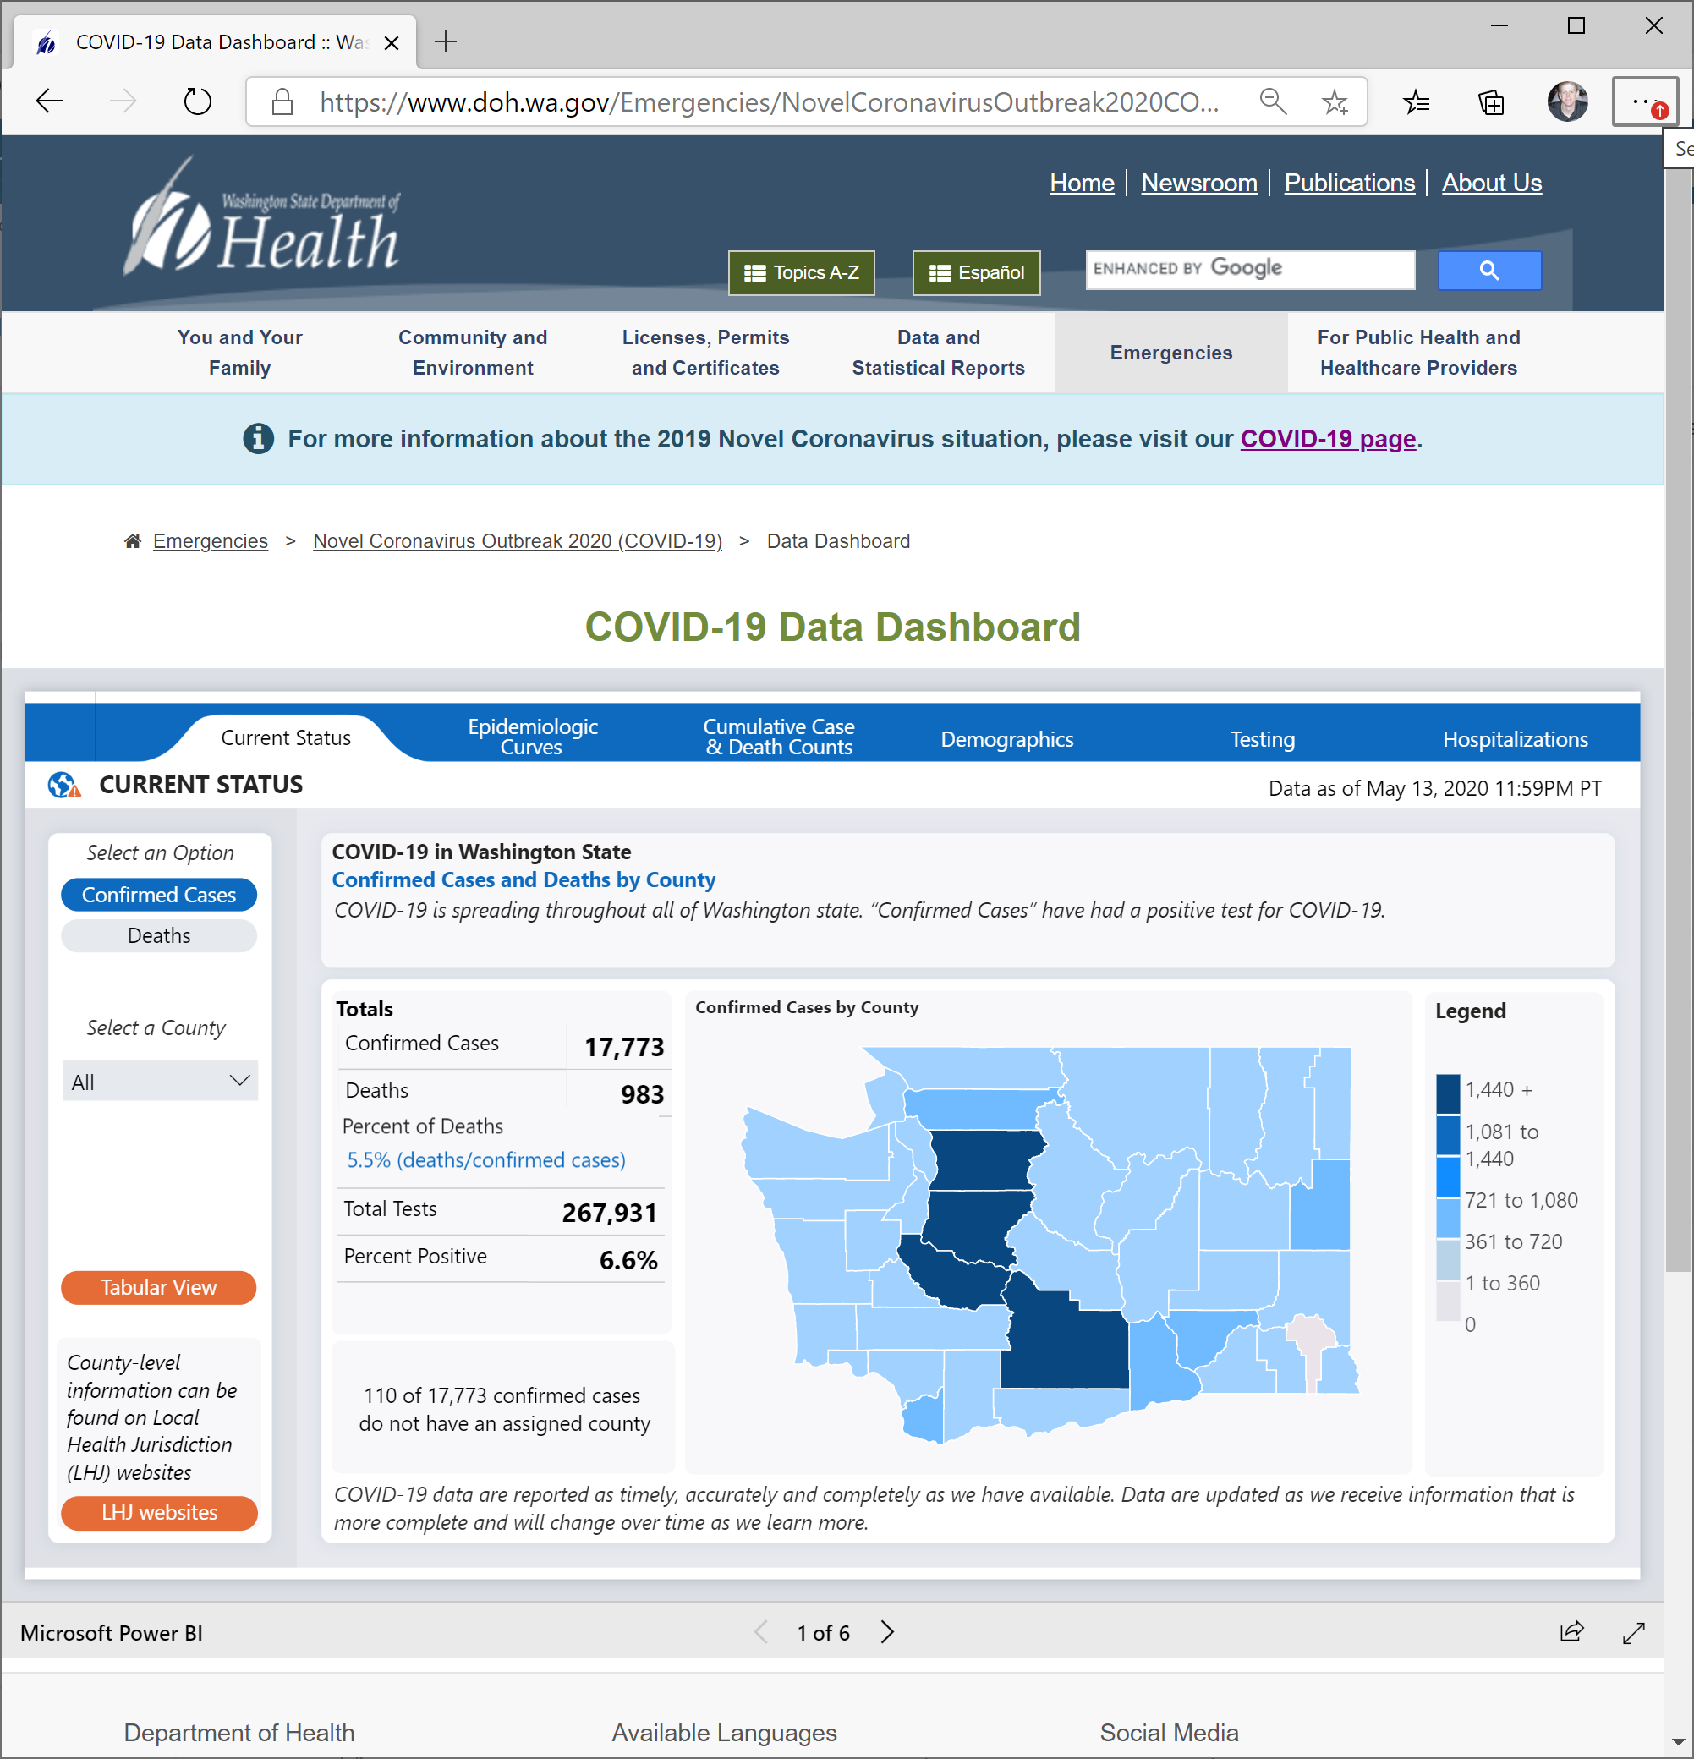
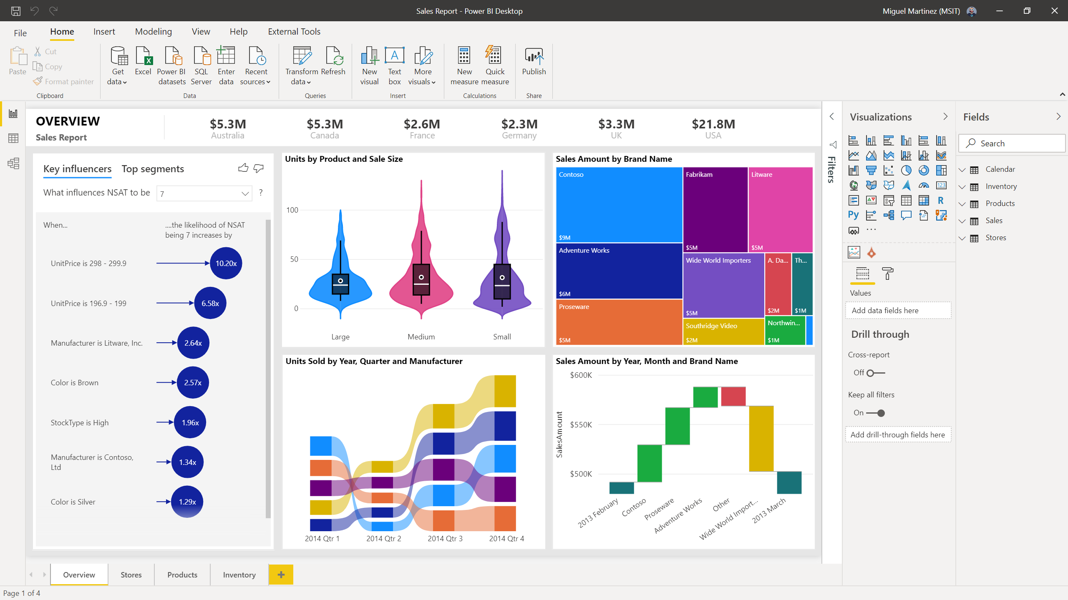
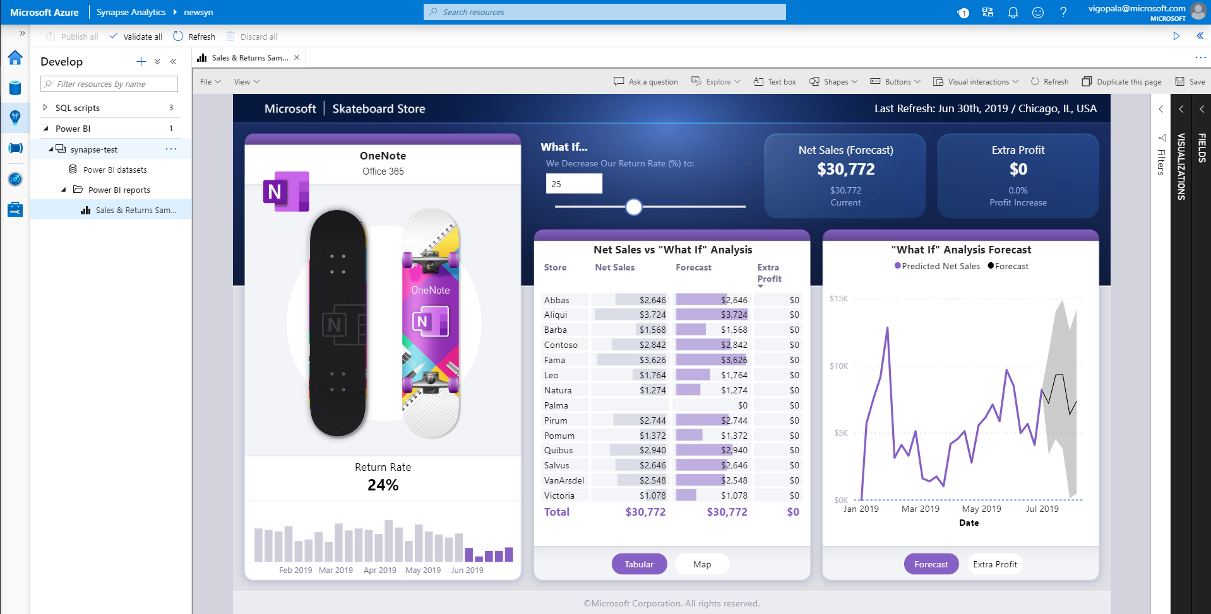
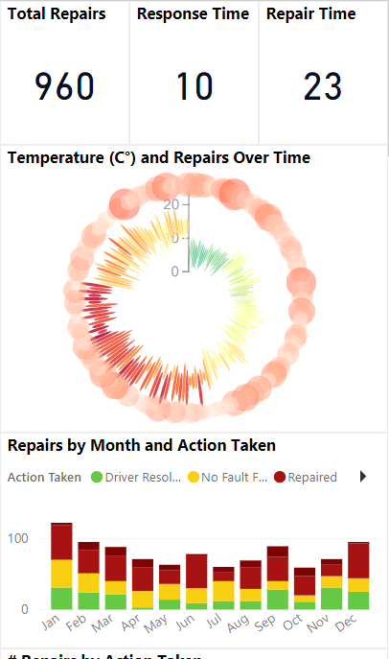
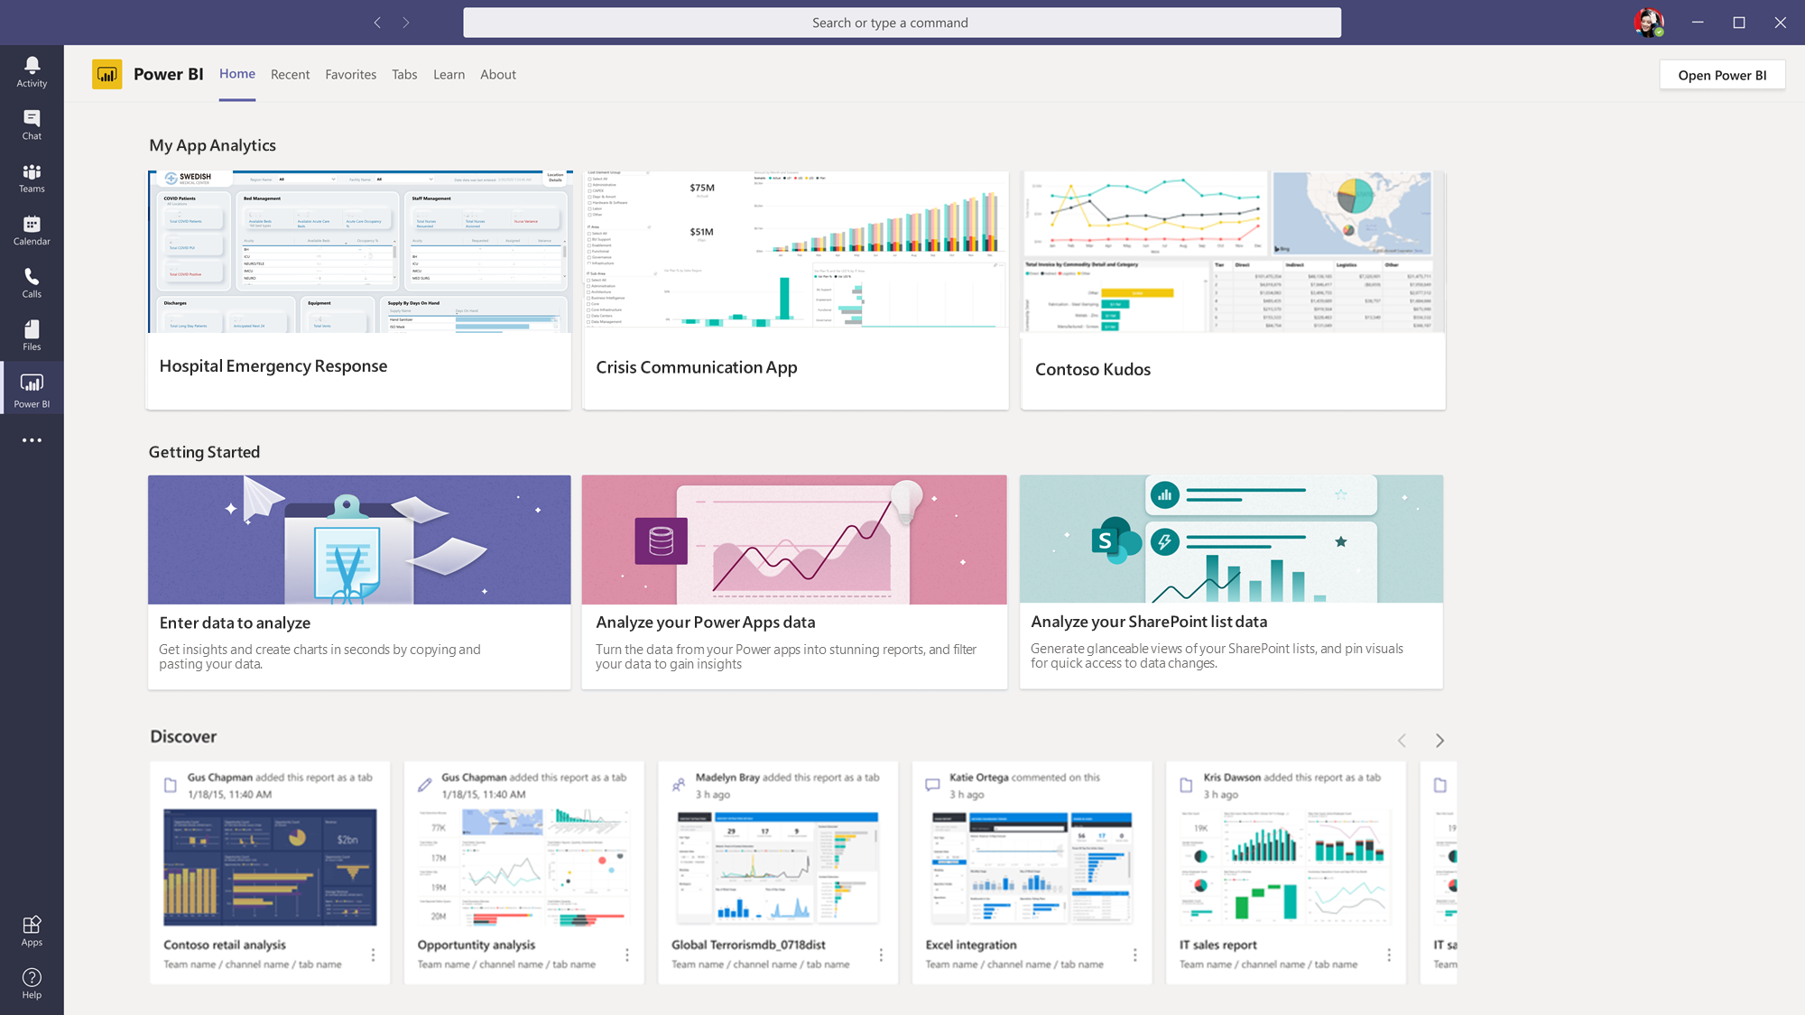
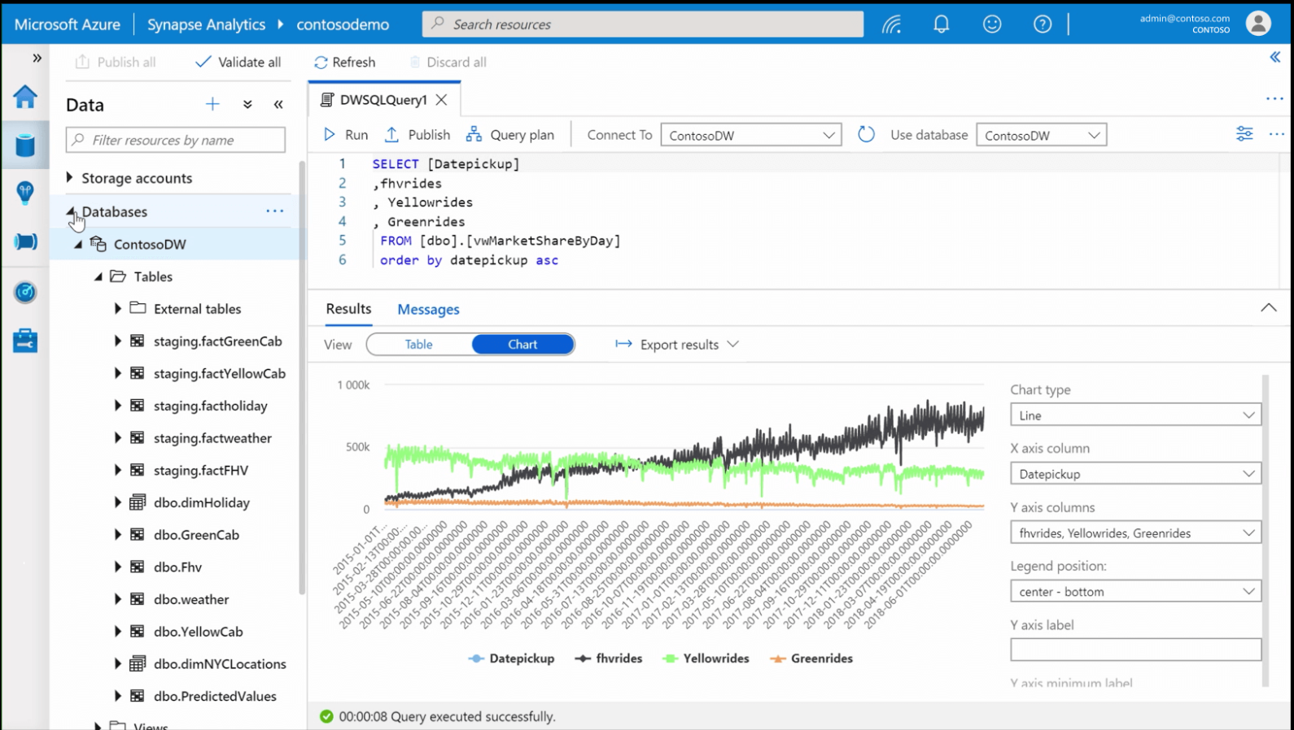
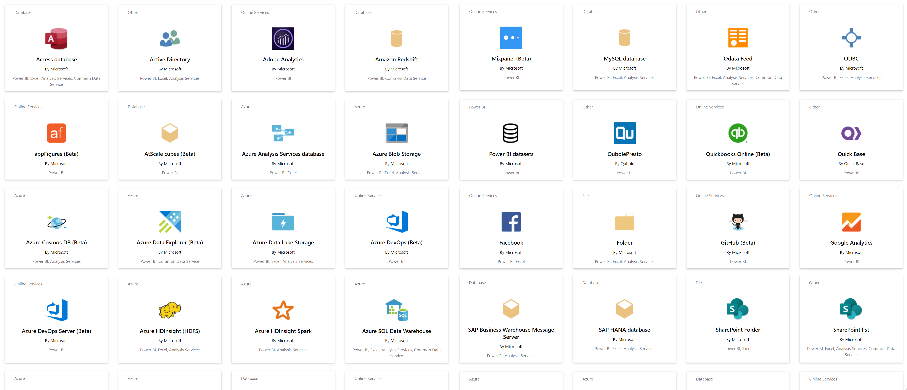
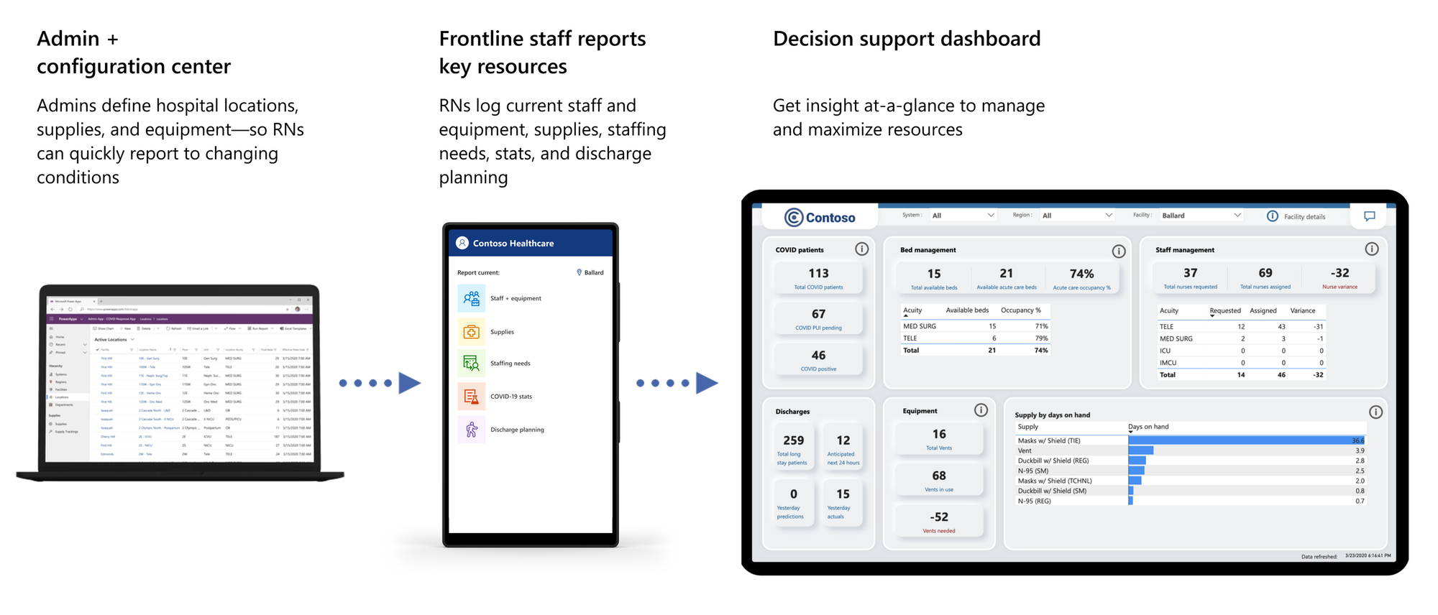
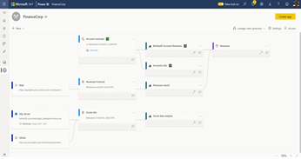
Power BI Overview and Demo
Power BI
All Data
For Everyone
For Every Decision
Break down data silos and enrich your data with intelligence
Create rich-interactive data experiences with AI infused insights
Integrate trusted and secure BI into the fabric of your organization and apps
Power BI drives a data culture for everyone and every decision
Source: https://powerplatform.microsoft.com/en-us/power-bi/
Notes:
Power BI started in 2011 (application was originally conceived as part of the SQL Server Reporting Services, bundled with SQL Server), but first released to the general public July 2015
Power BI is Microsoft’s augmented business intelligence platform, supporting dynamic visualization and analysis infused with the power of AI

Slide 10

Power BI Overview and Demo
Why Power BI?
Power BI Desktop is free
Real time dashboards and interactive reports
Natural Language query & AI insights
Custom visualizations and custom connectors
Integration with Excel, Power Point, SharePoint and Teams
Notes:
Why Power BI?
The Power BI Desktop report designer with endless possibilities, using more than 135 cloud and on-premise data sources, 250+ custom visualizations in addition to design templates and data shaping/transformation options.
Power BI will help connecting, loading/transforming the data and creating reports, dashboards, applications and data visualization.
Real time dashboard – In Power BI service, you can design a real time and interactive dashboard, using tiles, from the previously built and published reports. Real time capabilities are available for several of the visuals and the data sources.
Power BI service and desktop can answer natural language queries (in English & Spanish), as AI insights built into out of the box visualizations (Q&A, decomposition tree & Key Influencers)
Custom visuals can be added to the visuals gallery and custom visuals created by partners and community are available to be added to your report
The deliverables can be viewed on a variety of platforms. Power BI is integrating with Excel, Power Point, SharePoint and Teams, reports can be embedded in the platforms and data connectors can be used to connect to data stored in those platforms.

Slide 11
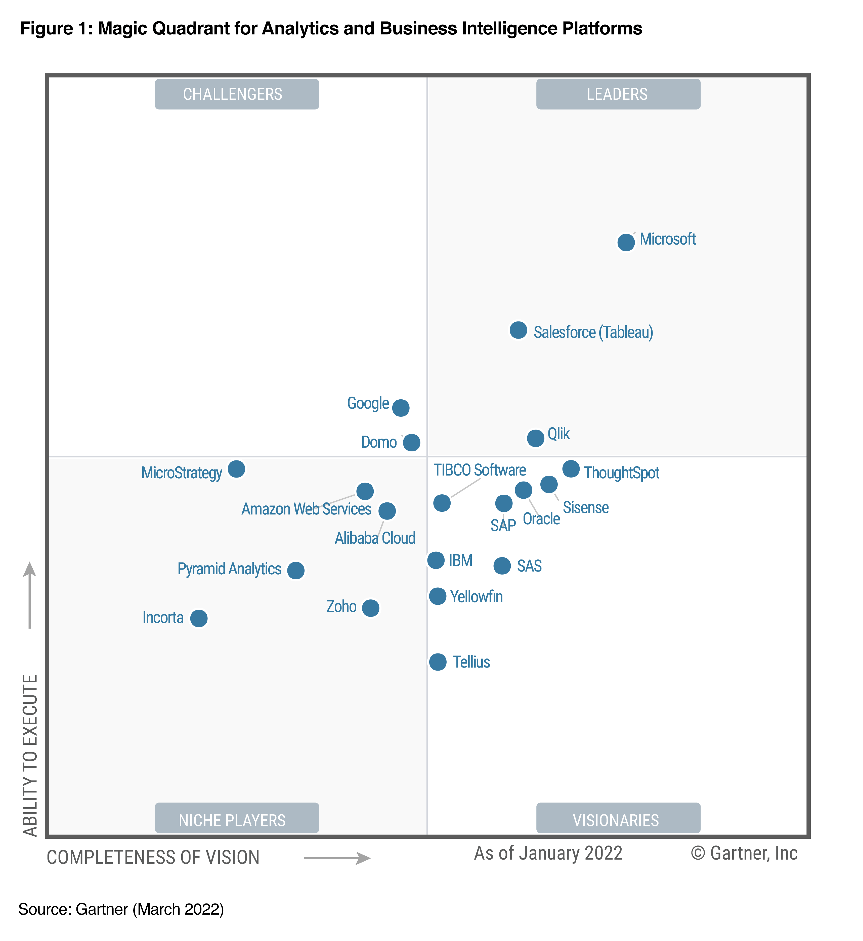
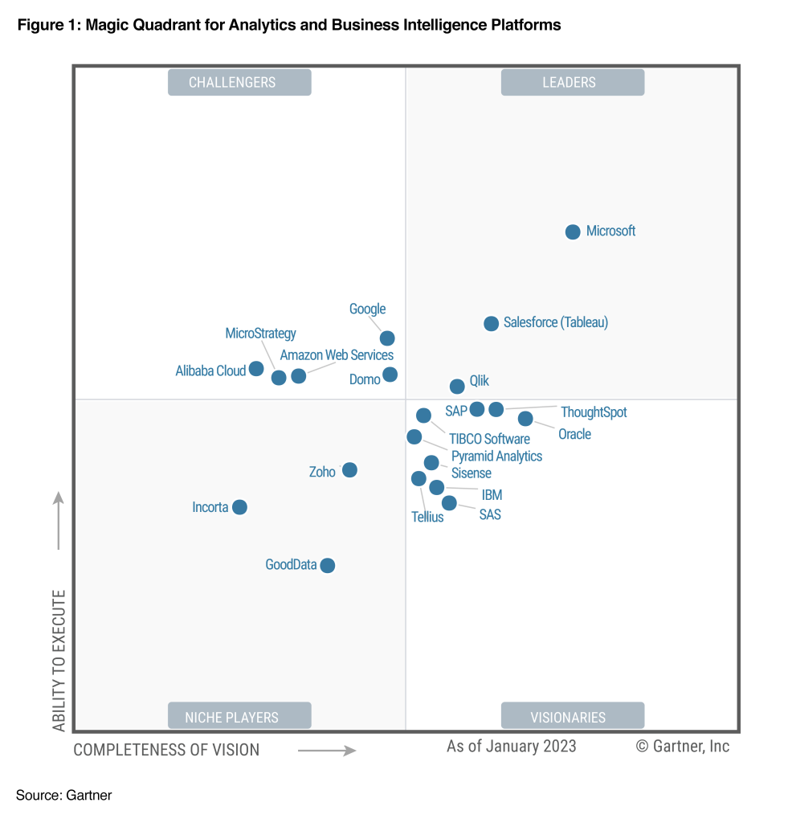
Power BI Overview and Demo
Gartner Magic Quadrant for Business Intelligence and Analytics Platforms 2022 v 2023
Source: https://powerbi.microsoft.com/en-us/blog/microsoft-named-a-leader-in-the-2023-gartner-magic-quadrant-for-analytics-and-bi-platforms/
Notes:
Microsoft was positioned highest for Ability to Execute and furthest for Completeness of Vision in the March 2022 Gartner® Magic Quadrant™ for Analytics and Business Intelligence Platforms.

Slide 12
Model for Instruction and Learning – Lab Approach
Lab approach… different from INFO 3300
LAB 1
LAB 2
LAB 3
LAB 4
Prepare
Explore
Analyze
Communicate
AND DAX

Slide 13

LAB 1 - Data preparation and DAX
Access all your data
Connect to 135 + data sources, both on-premises and cloud
Data from [the] organization
Big data and more
Azure data services, e.g., SQL DW, ADLS
On-premises data sources, e.g., Oracle, SSAS
Data from files
Import data from Text, CSV, Excel and Power BI Desktop files
Data sources
SaaS solutions
e.g., Marketo, Salesforce, GitHub, Google Analytics
Organizational Corporate data sources or external data services
On-premises Data
Azure services
Azure SQL, Stream Analytics…
Excel files
Power BI Desktop files
Data from files, databases, Azure, and other sources

Slide 14
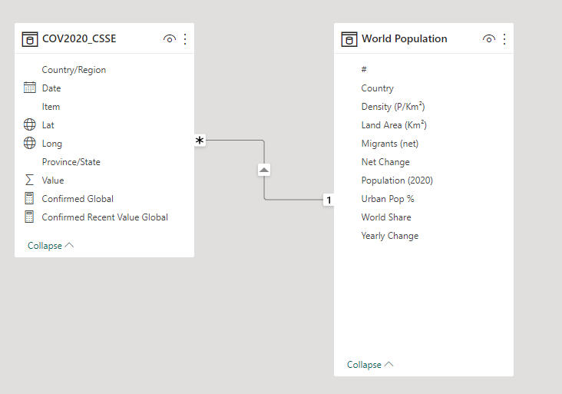
LAB 1 - Data preparation and DAX
Clean and mash-up data
Consolidate data from a broad range of sources
Merge or append queries to combine data from multiple queries into a single query
Transform data to fit needs using intuitive UI
Select data for inclusion
Cleanse data and remove errors
Build a data model
Data should have a “relationship”
Notes:
Power BI provides powerful capabilities that allow users to shape, transform, and clean their data for analysis. Data is rarely in the right format for analysis and a self-service business analysis tool must provide the flexibility to transform and clean data before it can be properly analyzed.
Power BI provides these capabilities as an integrated part of the data preparation experience, enabling more flexible, and ultimately a faster, experience for business analysts to work with data and build reports.

Slide 15
LAB 1 - Data preparation and DAX
Follow along with LAB 1 – Data preparation and DAX.docx

Slide 16
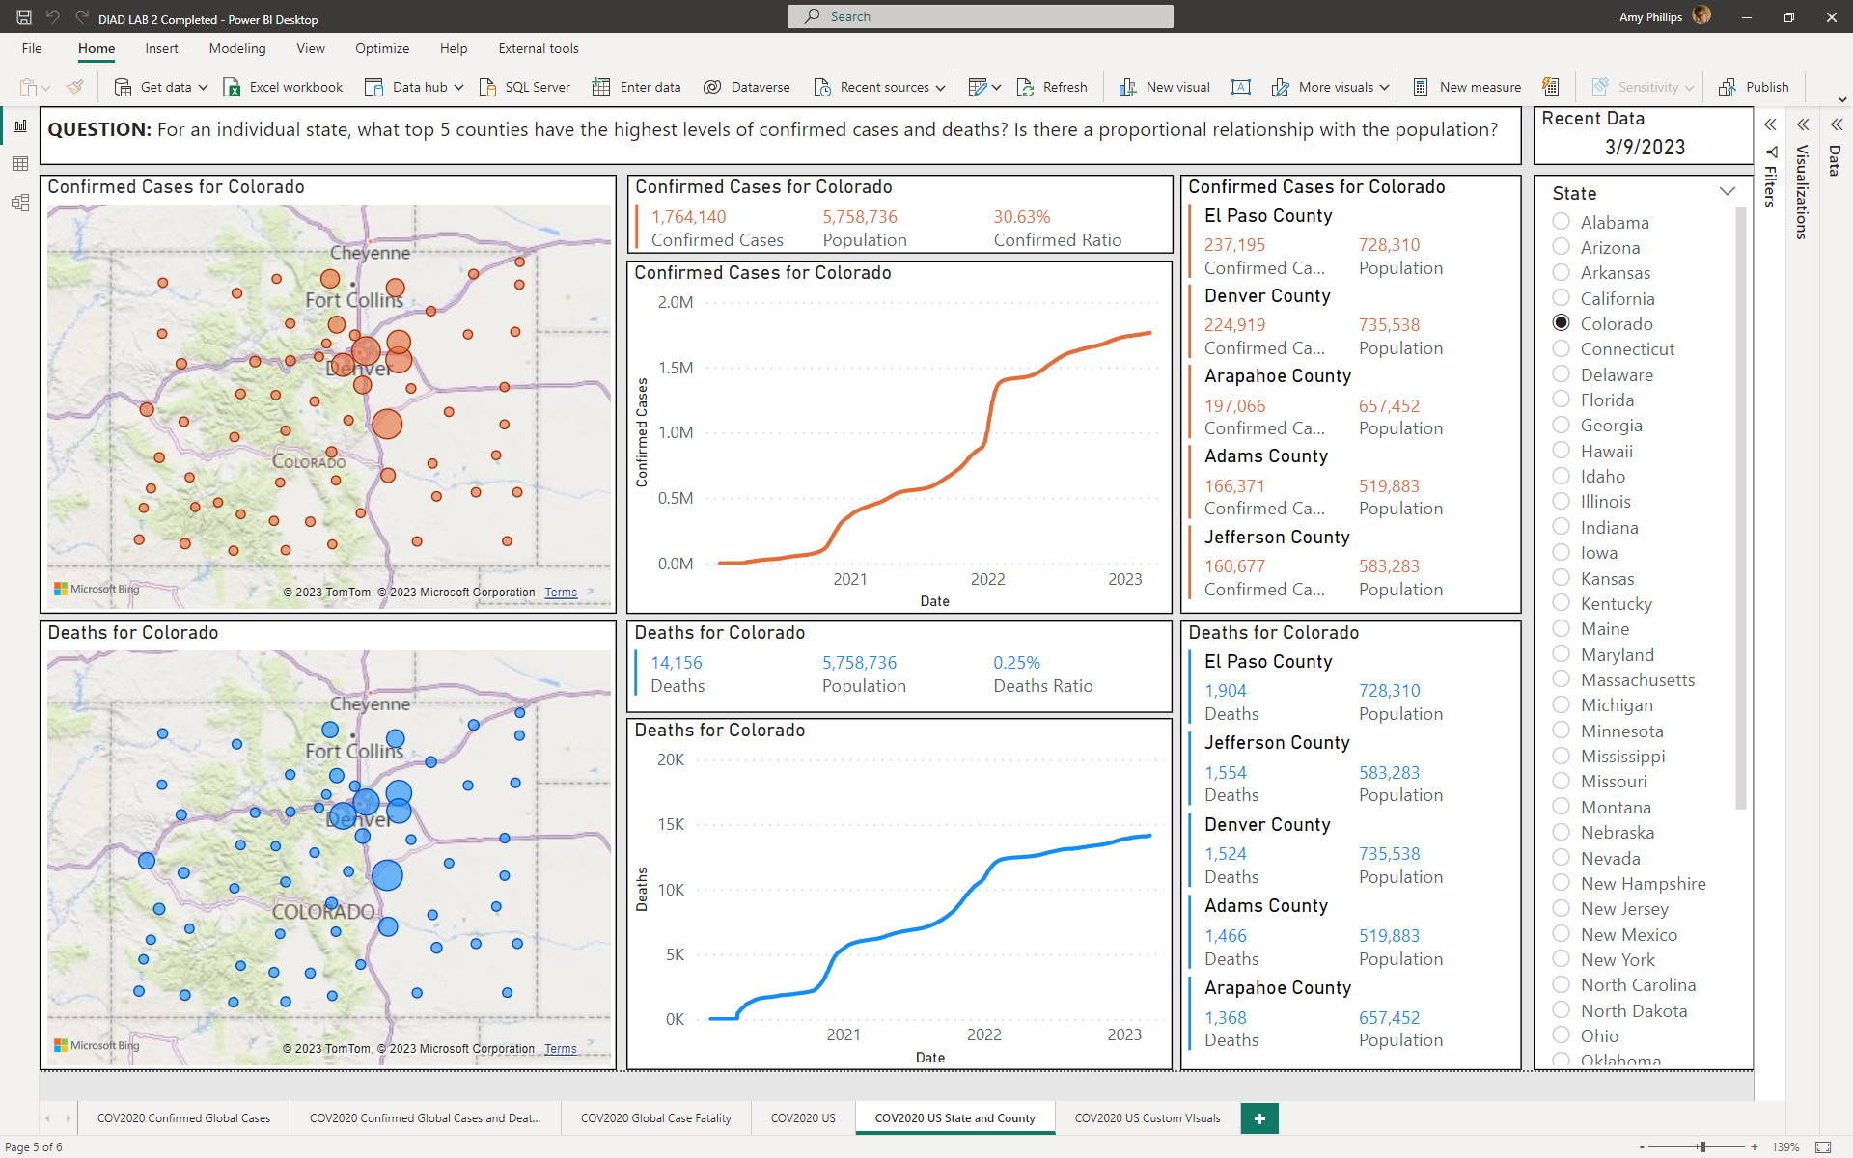
LAB 2 - Data exploration, visualization and DAX
Explore your data
In a variety of ways and across multiple visualizations using drag and drop canvas
Dig deeper into data
Drill-down in your hierarchical data
Filter, sort, hover over and highlight data

Slide 17
LAB 2 - Data exploration, visualization and DAX
Follow along with LAB 2 - Data exploration, data visualization and DAX.docx

Slide 18
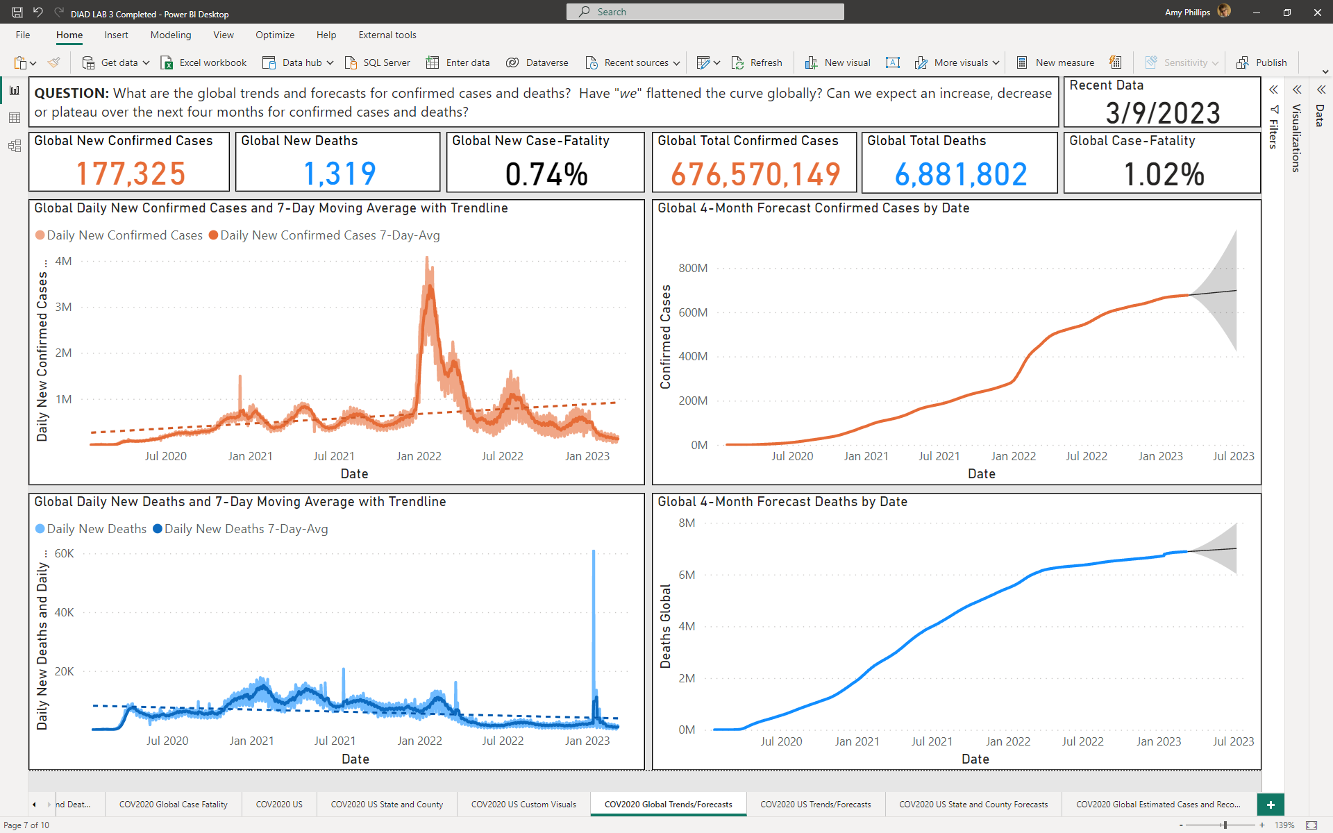
LAB 3 - Data analytics and DAX
Use the analytics options
Trend lines
Forecasts
Use parameters
What if scenarios

Slide 19
LAB 3 - Data analytics and DAX
Follow along with Lab 3 – Data analytics and DAX.docx

Slide 20
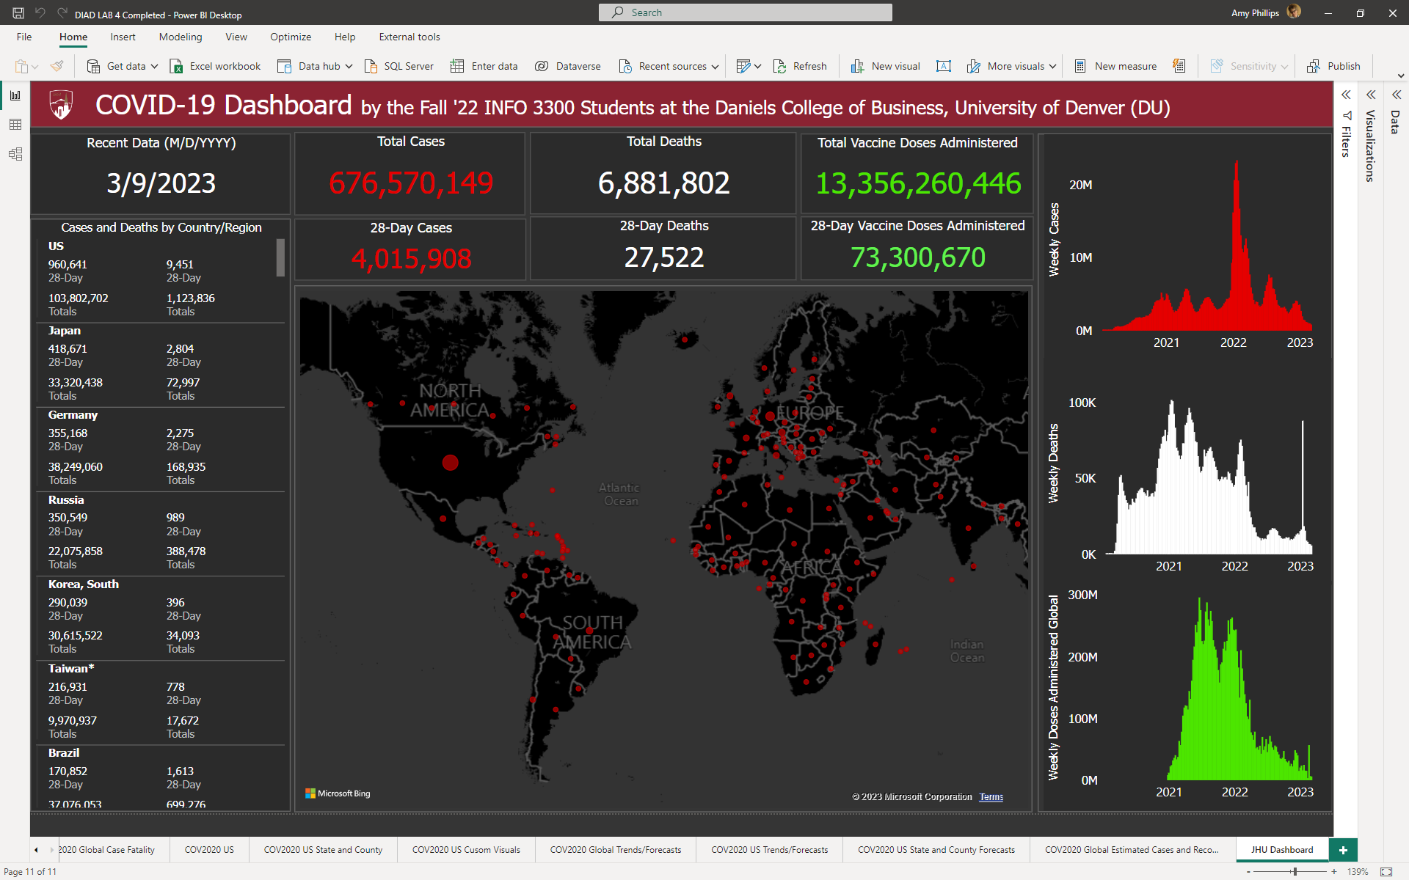
LAB 4 - Data communication and DAX
Building a *real* dashboard

Slide 21
LAB 4 - Data communication and DAX
Follow along with Lab 4 – Data communication and DAX.docx

Slide 22
Q&A
Q&A

